Slide 1

Cyclistic – Case study
I am Mazn Shkoor
GitHub: https://github.com/Mazn-Shkoor

Slide 2
Project purpose
Help the decision-making process behind supporting or opposing a marketing strategy that attempts to convert casuals into members.
Casuals (single pass purchasers).
Members (annual subscribers).

Slide 3
The challenge
How do annual members and casual riders use Cyclistic differently?

Slide 4
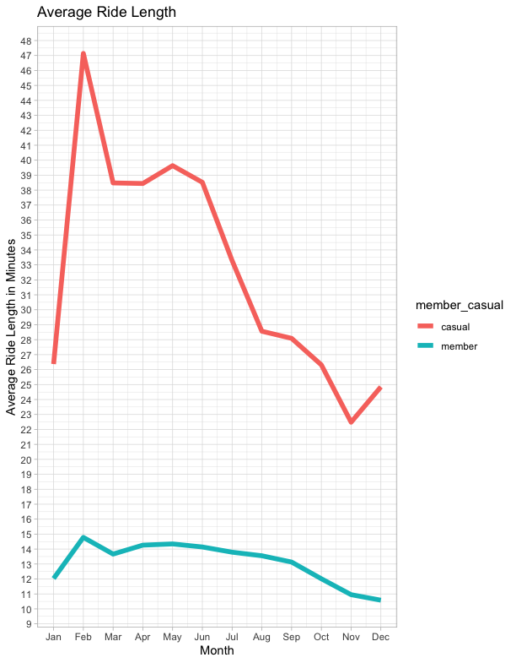
01 - Key Findings: average ride length
Casual riders tend to bike longer than annual member riders.
Casual riders prioritize biking for leisure.
Member riders prioritize biking for commuting.

Slide 5
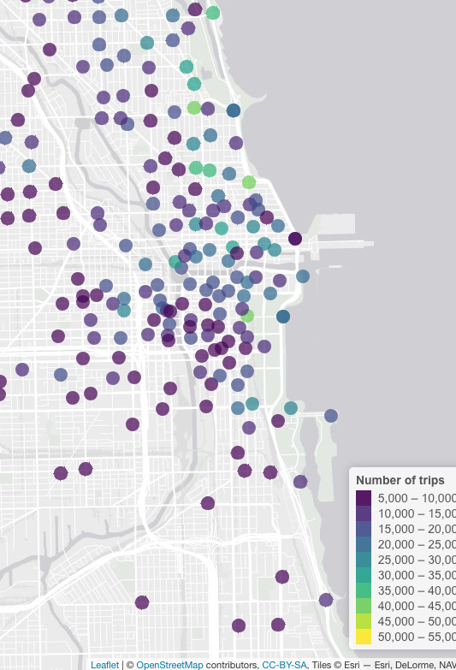
02 – key findings: geographical density
The most popular stations in terms of number of trips are next to the beach.
They are mostly during summertime.
They mostly bike for leisure.
This effects the ride length. Casual riders bike longer than member riders.

Slide 6
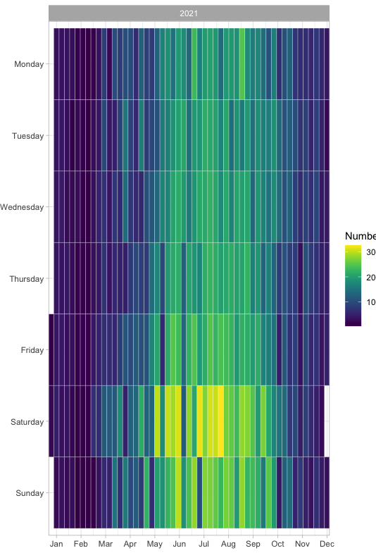
03 – key findings: Most popular time of the year
The most popular time of the year are between May and October.
Tourisms tend to bike more next to the beach during summertime.
The peak happens during weekends, Saturday and Sunday.

Slide 7
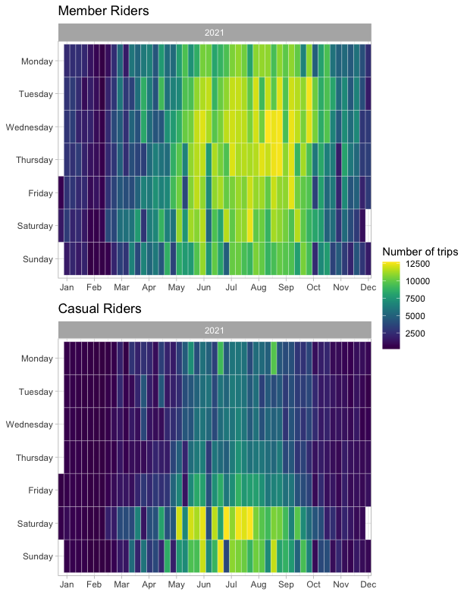
04 – key findings: Most popular time of the year per membership type
Member riders are peaking during the entire weekdays of summer.
Casual riders are peaking only during the weekends of summer.

Slide 8
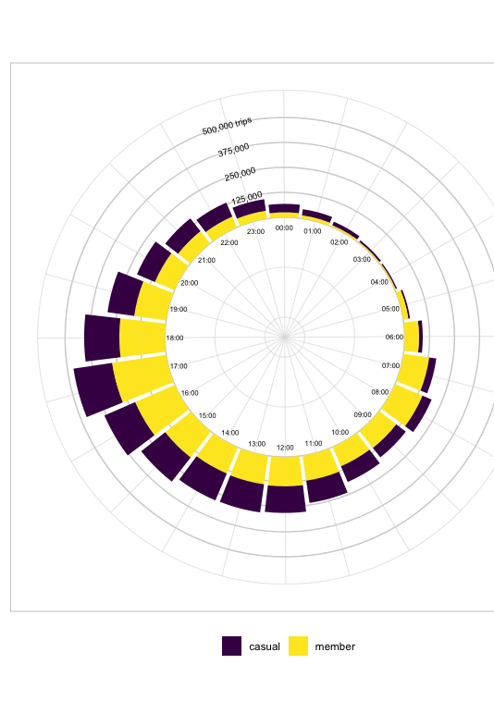
05 – key findings: most popular time of the day
Casual peak time are from 3:00 PM to 7:00 PM.
Mostly are tourisms biking during that time.
Member peak time are from 7:00 AM to 7:00 PM.
Mostly are people biking for commuting.

Slide 9
conclusion
Casual riders bike for longer duration.
Casual riders are most active on weekends during summertime.
Casual riders mostly use bikes for recreational purposes.

Slide 10
Recommendations
Design riding packages by keeping recreational activities, weekends, and summer events in mind and offer special discounts and coupons on such events to encourage casual riders get annual membership.
Design seasonal packages. It allows flexibility and encourage casual riders to get membership for specific periods if they are not willing to pay for annual subscription.
Effective and effectient promotions by targeting casual riders at busiest times:
Days: Saturday and Sunday
Months: May, June, July, August, September, and October.

Slide 11
Thank you!

